Slide 1
Intelligent Intranet
Implement Templates

Slide 2
Implement
Define solutions and design for the best landing experience

Slide 3






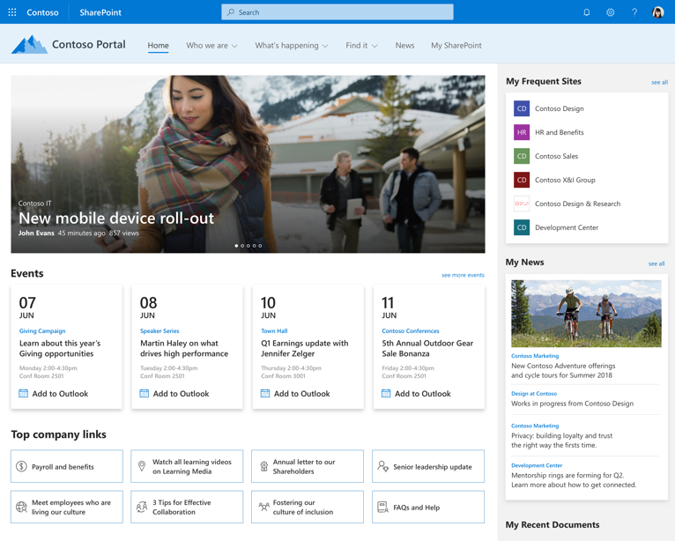
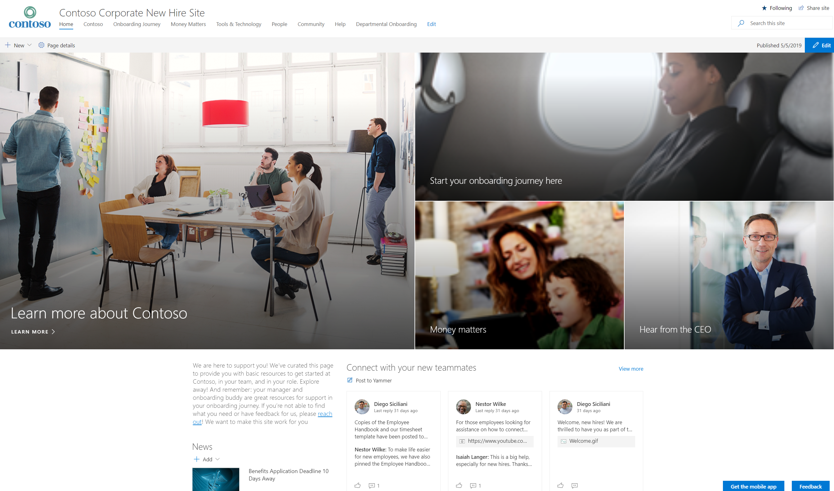
Define solutions based on business goals and scenarios
Business Priority
Scenario
Intranet landing page
Objectives
Metrics
Improve employee engagement
Intranet landing experience
Personas
Design
Solution
<Insert solution name>
Objectives
Metrics
<Insert scenario name>
Personas
Design

Slide 4
Solution objectives and measures
What are your objectives? How will you know if the solution achieves them?
Scenario: <Insert scenario name> |  | Measurement
Objective | Owner | KPI measure | Data source | KPI formula | KPI baseline | KPI target
Example: Increase employee engagement | HR | Change in employee engagement score | Employee engagement survey | Comparison of employee engagement survey results YoY | 70% | 80%
<Insert your objective> | <Insert owner of objective> | <Insert measure> | <Insert source> | <Insert formula> | <Insert baseline> | <Insert target>
<Insert your objective> | <Insert owner of objective> | <Insert measure> | <Insert source> | <Insert formula> | <Insert baseline> | <Insert target>
 |  | <Insert measure> | <Insert source> | <Insert formula> | <Insert baseline> | <Insert target>
<Insert your objective> | <Insert owner of objective> | <Insert measure> | <Insert source> | <Insert formula> | <Insert baseline> | <Insert target>
See notes pane for instructions on customizing this slide.
Notes:
Complete template for each solution that is in your plan
Each objective should have an owner, Key Performance Indicator (KPI) measure, defined data source (where you will source measurement data), KPI formula, KPI baseline and KPI target

Slide 5



Personas
Who will use your solution? What tools do they need to do their jobs?
Example: Knowledge Worker
<Insert persona name>
<Insert persona name>
“My goal is to find the information I need quickly and get my work done effectively”
“<Insert persona goal>”
“<Insert persona goal>”
<Insert persona name>
<Insert persona name>
“<Insert persona goal>”
“<Insert persona goal>”
See notes pane for instructions on customizing this slide.
Notes:
Define personas for each of the user types that will be using the solution
To build helpful personas, answer the following questions for each:
Who are the target users of the solution?
What are their goals?
How do they get their job done today?
What systems and tools do they use today?
3. Use surveys and interviews to collect the information necessary to build personas
4. Use the personas to inform your design

Slide 6
Solution experience design
<Insert experience image>
<Insert experience image>
<Insert experience image>
Personalized news and content
<Insert experience name>
<Insert experience name>
<Insert experience name>
Experiences
Keep people up-to-date with corporate, departmental, business unit and regional news
Engage audience with likes, comments, and social re-sharing
<Insert description of experience>
<Insert description of experience>
<Insert description of experience>
Components
SharePoint news web part
Audience targeting
<Insert Microsoft 365 component name>
<Insert Microsoft 365 component name>
<Insert Microsoft 365 component name>
See notes pane for instructions on customizing this slide.
Notes:
Break the solution up into a set of experiences
For each experience:
Build a mock-up
Describe the experience
Identify the set of SharePoint and Microsoft 365 components that will be used in each experience
Consider building user journey maps to further define your solution experiences

